Slide 1
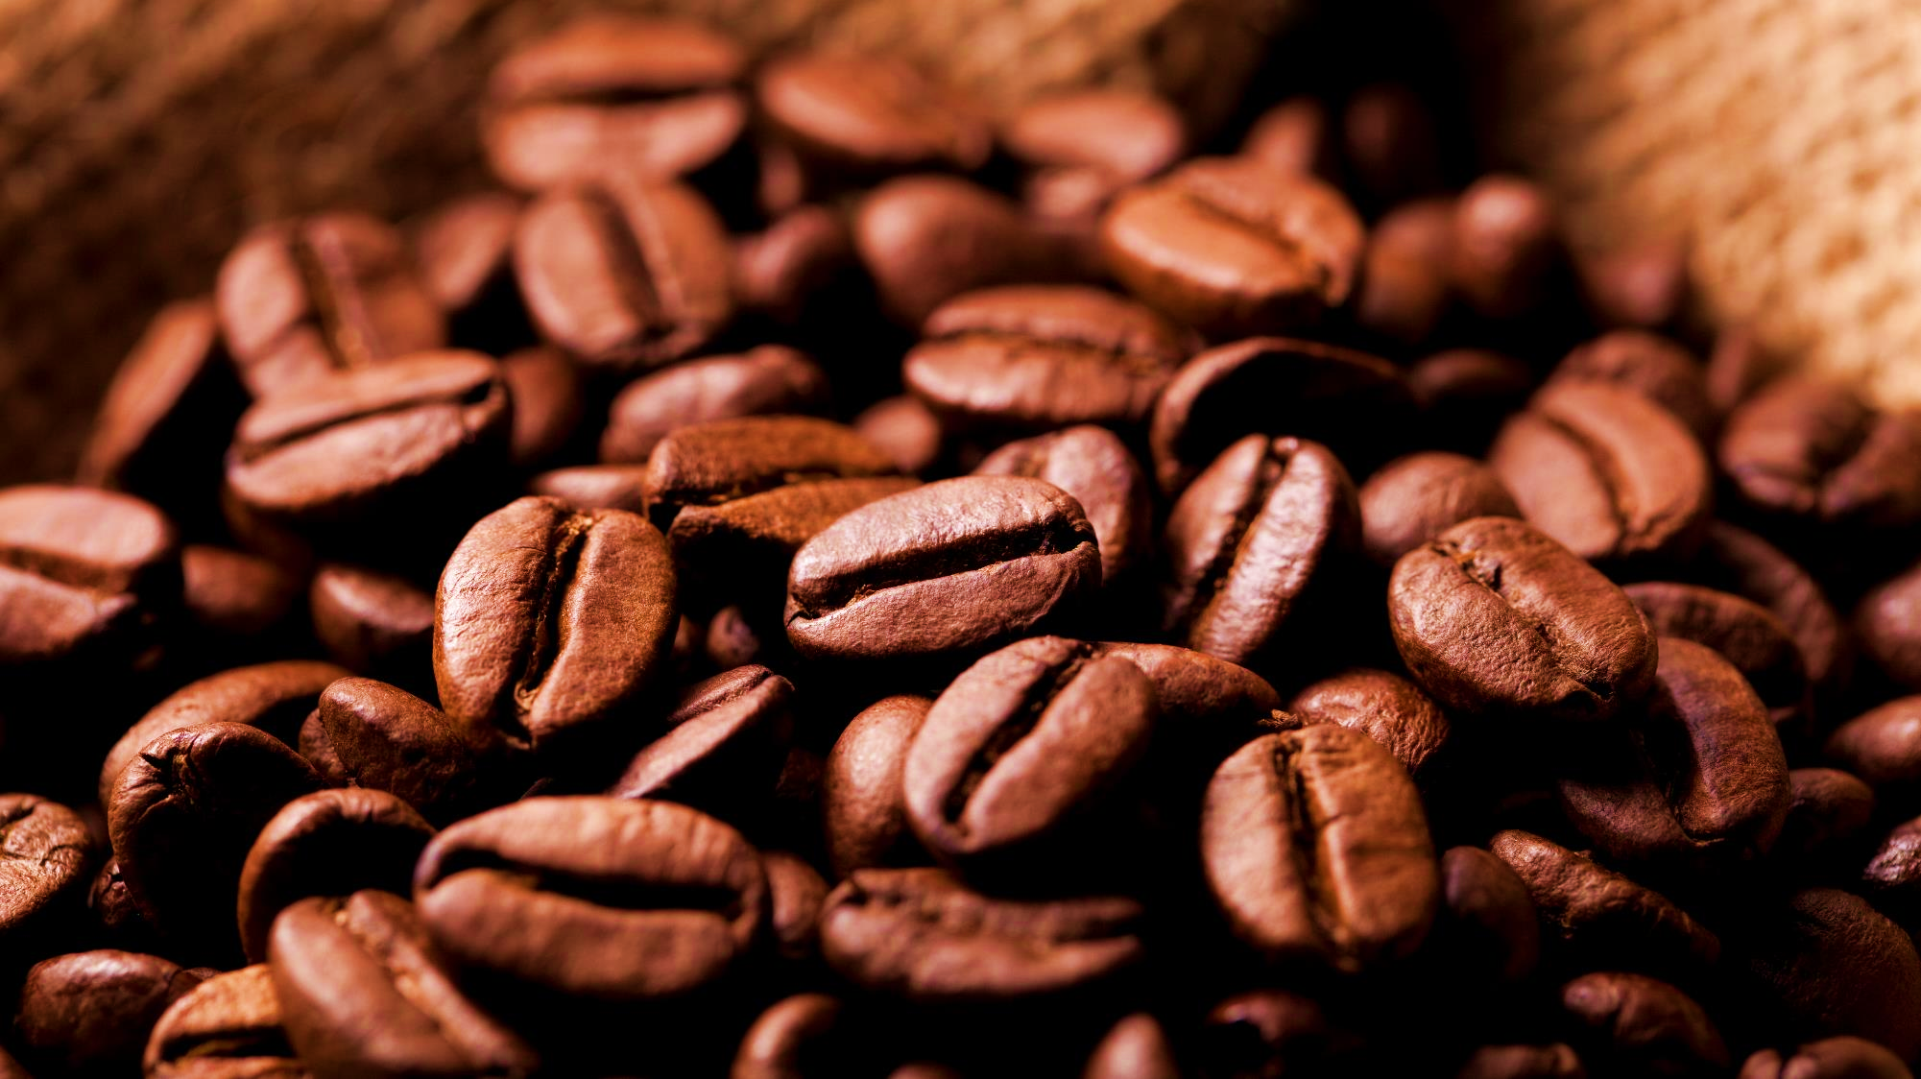
Bright coffee shop analysis
Brewing Connections, One Cup at a Time

Slide 2


BRIGHT COFFEE ANALYSIS SYNOPSIS
This is a three-store location coffee shop (Astoria, Hell’s Kitchen and Lower Manhattan)
This analysis is designed to help determine which products are top selling throughout the store location by means of the total revenues/sales, to help determine and improve the business.
This presentation will help with determine what needs to be done for the company to grow in revenue and improve the product performance.

Slide 3
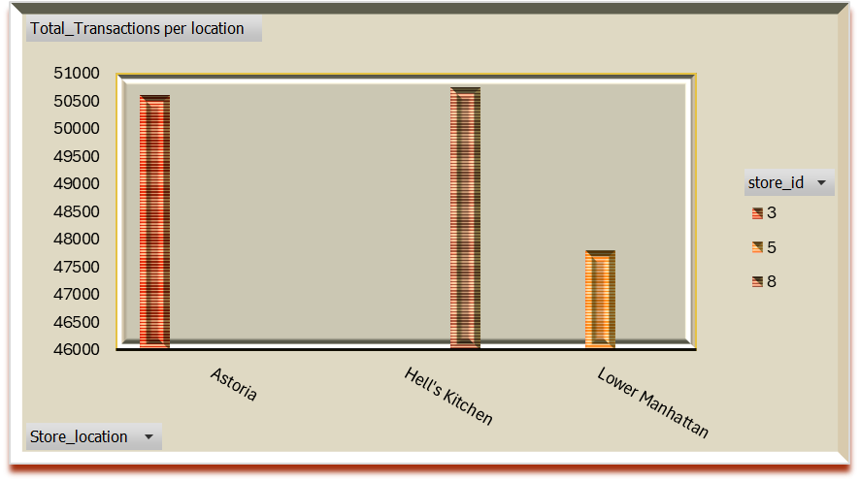
Total transactions per location This displays the number of transactions occurring at each store location over the months

Slide 4
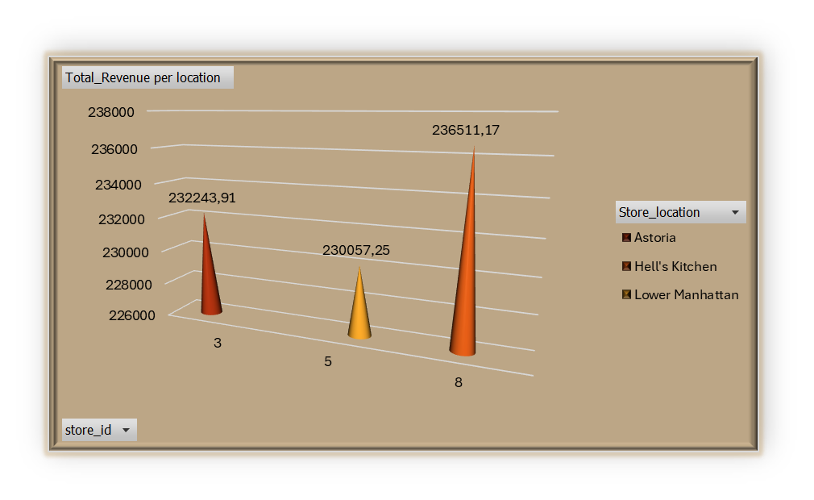
Total Revenue per Store location This provides information on the total revenue generated by each store location.

Slide 5
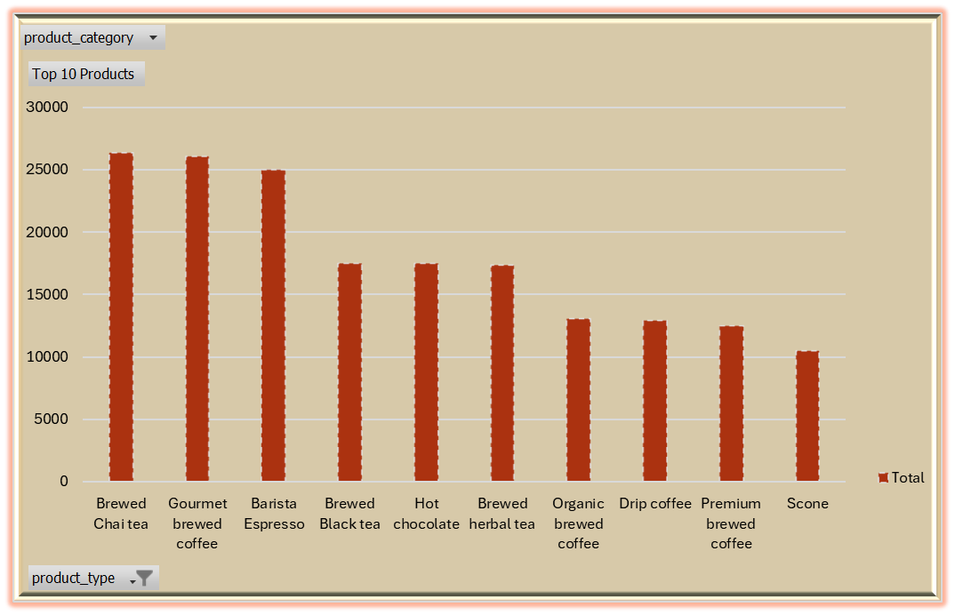
Top 10 Products This shows the top 10 products purchased, ranked by quantity sold.

Slide 6
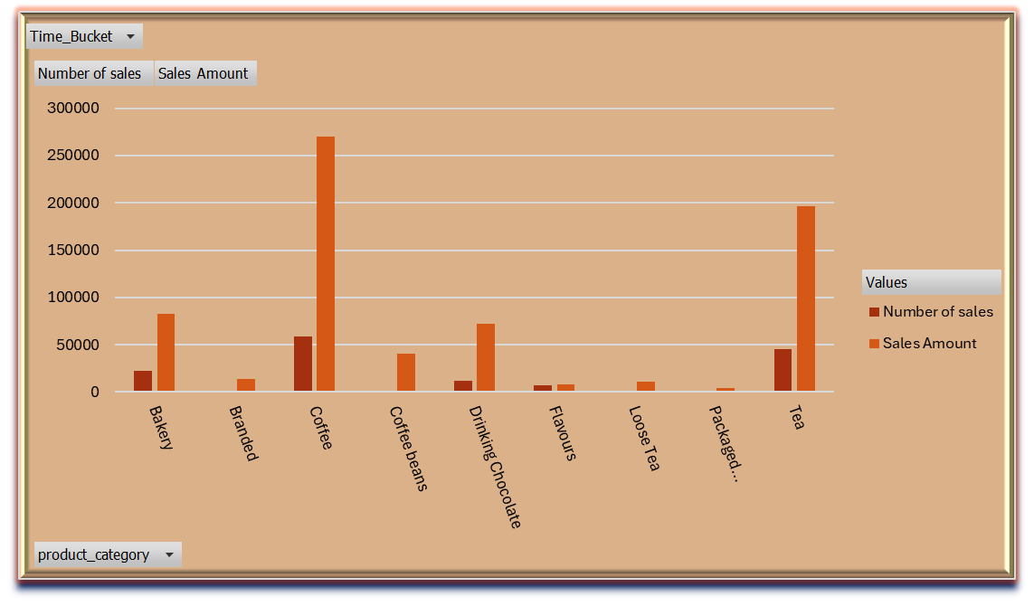
Sales by Product Category & peak hour sales This shows the number of sales per product category, broken down by time buckets (morning, afternoon, evening, night) to analyse sales volume.

Slide 7
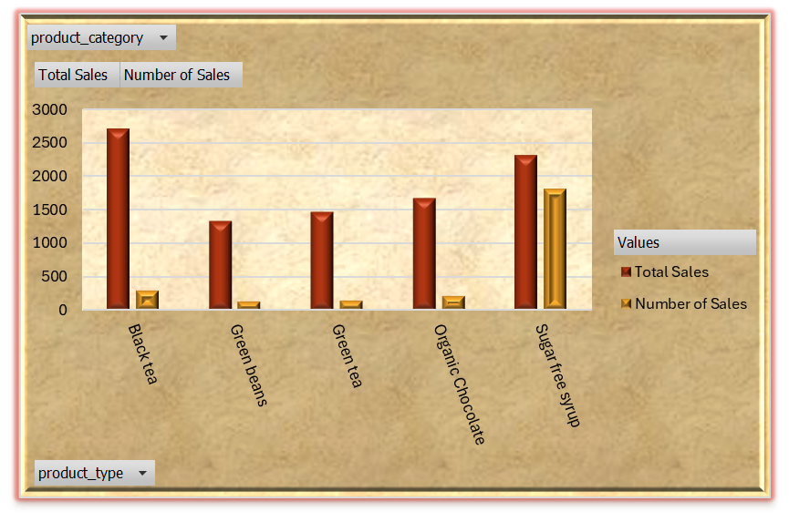
Worst selling products by Sales This displays the five products with the lowest sales volume, highlighting items that have been purchased the least.

Slide 8
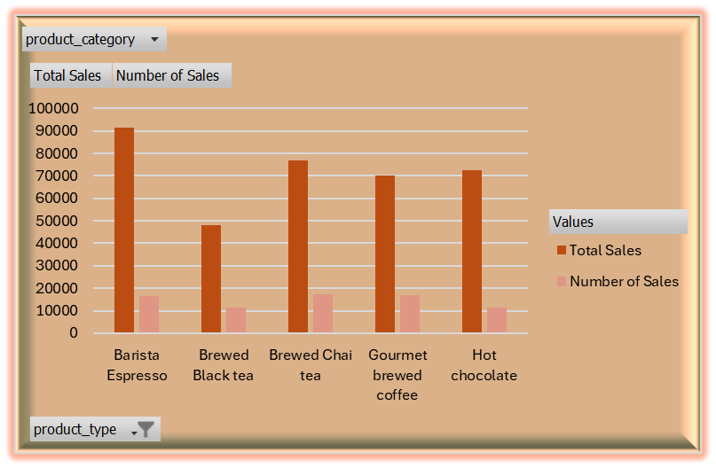
Best Selling products by Sales This displays the five products with the highest sales volume, highlighting the top-selling items.

Slide 9
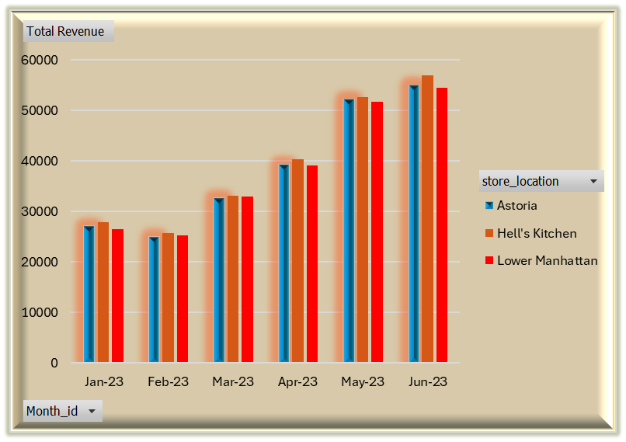
Total revenue by Month & store Location This displays the total revenue generated each month, aggregated across all store locations to provide an overview of overall monthly performance.

Slide 10

